Slide 1

MEDIVAULT
A Digital Health Record System
TEAM NAME: CODE COMMANDERS
PROJECT THEME: HEALTH AND WELL BEING

Slide 2
PROBLEM STATEMENT
The Problem:
Many patients rely on paper-based medical records. These records are often:
Lost, damaged, or misplaced, making it difficult for doctors to track a patient’s medical history.
Scattered across different hospitals and clinics, leading to inconsistent treatment.
Not easily accessible during emergencies, where quick access to medical history could be life-saving.

Slide 3
SOLUTION
MediVault is a web-based digital health records system that allows patients to:
Store and manage their medical records online without needing an app or complex setup.
Access their records using only registered usernames and passwords.
Easily retrieve past medical reports, prescriptions, and test results when visiting different doctors.
Download and share records as PDFs for seamless healthcare access.

Slide 4
FEATURES
1. Patient Record Management
Users can enter a patient's name and medical history.
The record is saved with a timestamp for reference.
The records are stored in local storage (browser-based storage).
2. Search & Manage Records
Users can search records by patient name.
Existing records can be edited or deleted.
Displays all stored records clearly and neatly.
3. Prescription Upload & Extraction
Users can upload a prescription (image/PDF).
Extracts medicine names from the prescription
Shows a preview of the uploaded prescription.
Extracted medicine names are displayed with the date of extraction.
4. Download Records as a File
Users can download all stored records as a text file for future reference.

Slide 5
HOW IT WORKS
Step 1: Create a secure username and password.
Step 2: Upload prescriptions (image/PDF format).
Step 3: MediVault automatically extracts relevant data, like medicine names, from the documents.
Step 4: Store, organize, and manage your medical records in a searchable format.
Step 5: Download records as text files or share as needed.

Slide 6
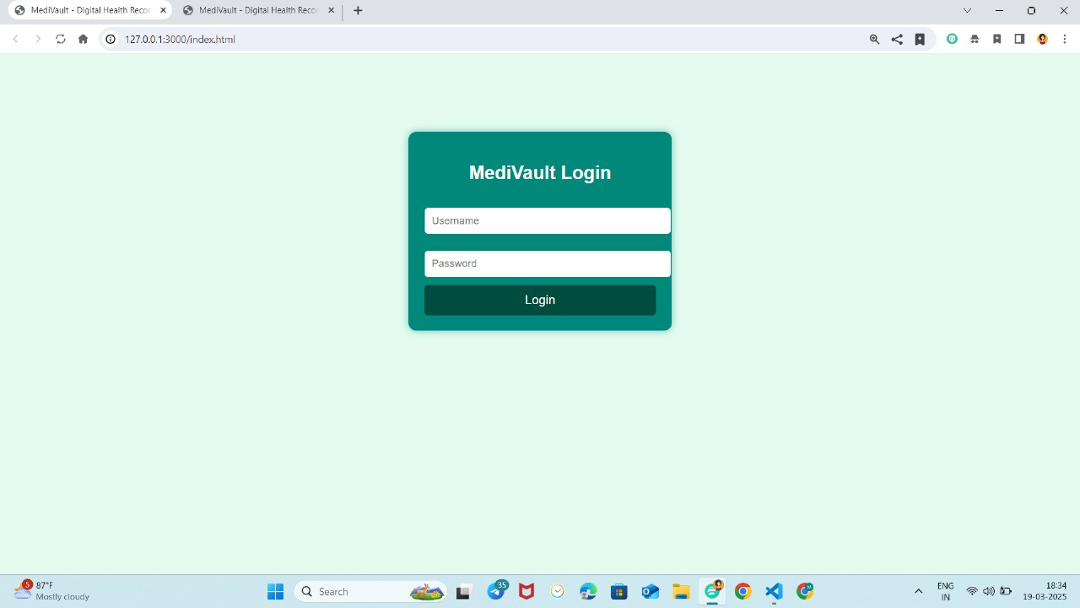
WALKTHROUGH THROUGH
OUR WEBSITE

Slide 7
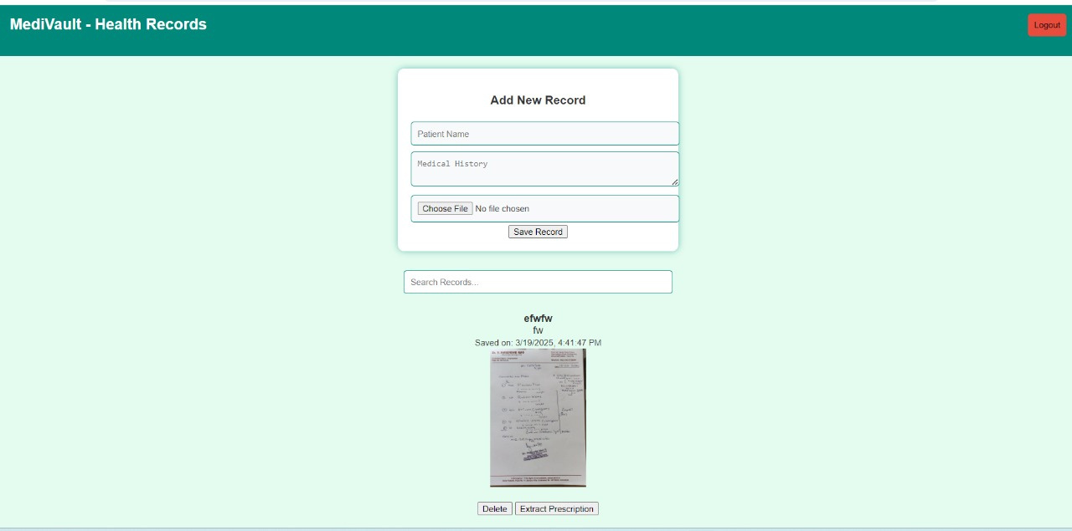

Slide 8
THANKYOU
TEAM CODE COMMANDERS:

